Slide 1
Introduction to Machine Learning
Module -1
Chapter -1

Slide 2

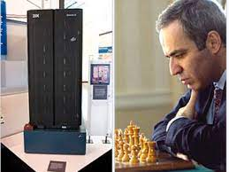
First Encounter of Machine Learning
The computer program was IBM’s Deep Blue and it defeated world chess champion, Gary Kasparov.
While Deep Blue was searching some 200 million positions per second,
Kasparov was searching not more than 5–10 positions probably, per second.

Slide 3
Continue….
It can recommend toys to toddlers
It can suggest a technology book to a geek
It recommends rich title in literature to a writer.
It predicts the future market to help amateur traders compete with seasoned stock traders.
It helps an oncologist find whether a tumour is malignant or benign.
It helps in optimizing energy consumption thus helping the cause of Green Earth.

Slide 4

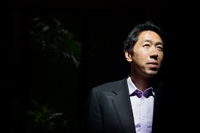
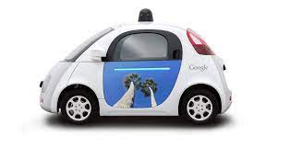

Continue…
Google has become one of the front-runners focusing a lot of its research on machine learning and artificial intelligence –
Google self-driving car (Sebastian Thrun, the former director of the Stanford Artificial Intelligence Laboratory (SAIL) 2009)
Google Brain (Enable robots to complete tasks by learning from experience, Andrew Ng )

Slide 5
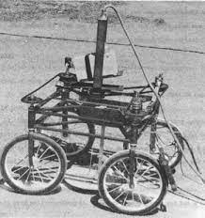
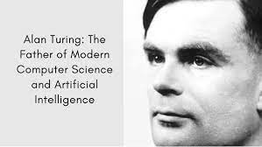
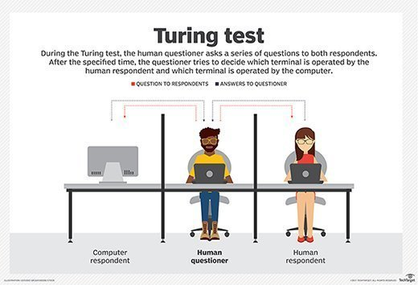
The Evolution of Machine Learning
🚗 1961 – Stanford Cart (First autonomous wheeled robot). 🚗 1986 – Mercedes-Benz (First AI-based self-driving car). 🚛 2004-2007 – DARPA Grand Challenge (Major innovation in self-driving cars). 🚕 2010+ – Google/Waymo, Tesla, and others advance self-driving technology.

Slide 6
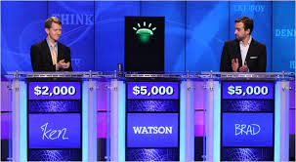
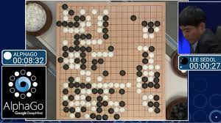

Slide 7
1.2 WHAT IS HUMAN LEARNING?
In our daily life, we need to carry out multiple activities
Simple or it may be some complex task
To do a task in a proper way, we need to have prior information on one or more things related to the task
As we keep learning more or in other words acquiring more information, the efficiency in doing the tasks keep improving.

Slide 8
1.3 TYPES OF HUMAN LEARNING
Human learning happens in one of the three ways –
(1) Either somebody who is an expert in the subject directly reaches us.
(2) We build our own notion indirectly based on what we have learnt from the expert in the past.
(3) We do it ourselves, may be after multiple attempts, some being unsuccessful.

Slide 9

1.3.1 Learning under expert guidance
Falls under the category of learning directly under expert guidance
Guided learning is the process of gaining information from a person having sufficient knowledge due to the past experience

Slide 10
1.3.2 Learning guided by knowledge gained from experts
The second type falls under learning guided by knowledge gained from experts
There is no direct learning. It is some past information shared on some different context, which is used as a learning to make decisions

Slide 11
1.3.3 Learning by self
Third type is learning by self or self-learning
Humans are left to learn on their own
Not all things are taught by others
A lot of things need to be learnt only from mistakes made in the past.

Slide 12
1.4 WHAT IS MACHINE LEARNING?
‘A computer program is said to learn from experience E with respect to some class of tasks T and performance measure P, if its performance at tasks in T, as measured by P, improves with experience E.’
By Tom M Mitchell, Professor of Machine Learning Department, School
of Computer Science, Carnegie Mellon University

Slide 13
Continue…
In the context of the learning to play checkers,
E represents the Experience of playing the game,
T represents the Task of playing checkers and
P is the Performance measure indicated by the percentage of games
won by the player.

Slide 14
Continue…
The same mapping can be applied for any other machine learning problem, for example, Image Classification Problem.
In context of image classification,
E represents the past data with images having labels or assigned classes (for
example whether the image is of a class cat or a class dog or a class elephant
etc.),
T is the task of assigning class to new, unlabelled images
P is the performance measure indicated by the percentage of images correctly
classified.

Slide 15
1.4.1 How do machines learn?
The basic machine learning process can be divided into three parts.
1. Data Input: Past data or information is utilized as a basis for
future decision-making
2. Abstraction: The input data is represented in a broader way
through the underlying algorithm
3. Generalization: The abstracted representation is generalized
to form a framework for making decisions

Slide 16
Schematic representation of the machine learning process

Slide 17
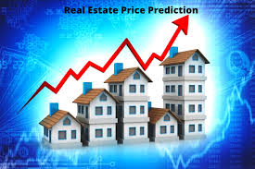
Data Input: Collect past data for learning (e.g., house prices ).
Data Input
🔹 Definition:
The model receives raw data as input.
This data can be structured (e.g., databases, spreadsheets) or unstructured (e.g., images, text, videos).
The goal is to use past data to make future predictions.
🔹 Example:
In house price prediction, the input data includes:
House size (sq. ft)
Number of bedrooms
Location
Price (historical data)

Slide 18
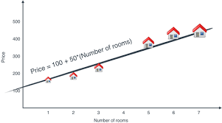
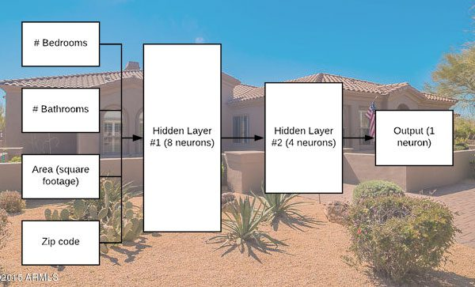
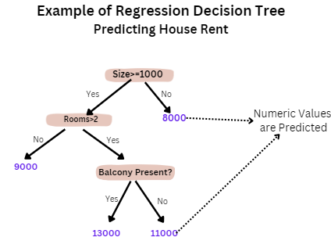
Abstraction: Use algorithms to find patterns in the data (e.g., price increases with house size )
Definition:
The input data is processed and transformed into a mathematical model using algorithms.
The goal is to extract meaningful patterns and relationships.
Different machine learning algorithms are used for abstraction, such as:
Linear Regression (for predicting continuous values)
Decision Trees (for classification)
Neural Networks (for deep learning tasks)
Example:
In house price prediction, the algorithm learns patterns such as:
"Larger houses tend to have higher prices."
"Urban areas have more expensive houses than rural areas."

Slide 19
Generalization: Apply learning to new cases (e.g., predict price of a new house ).
Definition:
The model applies what it has learned to new, unseen data to make accurate predictions.
A good model doesn’t just memorize past data but generalizes well to real-world scenarios.
This step ensures that the model performs well on new examples rather than just the training data.
Example:
In house price prediction, once trained, the model can predict the price of a new house based on its features.
The model generalizes its learning to new houses that were not in the original dataset.

Slide 20
Data Input
During the machine learning process, knowledge is fed in the form of input data.
The data cannot be used in the original shape and form.

Slide 21
1.4.1.1 Abstraction
The first part of machine learning process is abstraction i.e. abstract the knowledge which comes as input data in the form of a model.
However, this abstraction process, or more popularly training the model, is just one part of machine learning.
The input data based on which the model is being finalized is known as training data.

Slide 22
Continue…
The model may be in any one of the following forms:
Computational blocks like if/else rules
Mathematical equations
Specific data structures like trees or graphs
Logical groupings of similar observations

Slide 23
Continue…
The decision related to the choice of model is taken based on multiple aspects, some of which are listed below:
The type of problem to be solved:
Whether the problem is related to forecast or prediction, analysis of trend, understanding the different segments or groups of objects, etc.
Nature of the input data: How exhaustive the input data is, whether the data has no values for many fields, the data types, etc.
Domain of the problem: If the problem is in a business critical domain with a high rate of data input and need for immediate inference, e.g. fraud detection problem in banking domain.

Slide 24
Continue…
Once the model is chosen, the next task is to fit the model based on the input data.
Let’s understand this with an example.
In a case where the model is represented by a mathematical equation, say ‘y = c1 + c2 x’, based on the input data, we have to find out the values of c1 and c2 and x.
Otherwise, the equation (or the model) is of no use.

Slide 25
1.4.1.2 Generalization
The other key part is to tune up the abstracted knowledge to a form which can be used to take future decisions.
This is achieved as a part of generalization, which is quite difficult to achieve because the model is trained based on a finite set of data, which may possess a limited set of characteristics.

Slide 26
Continue…
But when we want to apply the model to take decision on a set of unknown data, usually termed as test data, we may encounter two problems:
1. The trained model is aligned with the training data too much, hence may not portray the actual trend.
2. The test data possess certain characteristics apparently unknown
to the training data.

Slide 27
1.4.2 Well-posed learning problem
For defining a new problem, which can be solved using machine learning, a simple framework can be used.
This framework also helps in deciding whether the problem is a right candidate to be solved using machine learning.

Slide 28
The framework involves answering three questions:
1. What is the problem?
2. Why does the problem need to be solved?
3. How to solve the problem?

Slide 29
Step 1: What is the Problem?
A number of information should be collected to know
what is the problem.
Informal description of the problem,
e.g. I need a program that will prompt the next word as and when I type a word.

Slide 30
Example:
Machine learning formalism stated above to define the T, P, and E for the problem.
For example:
Task (T): Prompt the next word when I type a word.
Experience (E): A corpus of commonly used English words and
phrases.
Performance (P): The number of correct words prompted
considered as a percentage (which in machine
learning paradigm is known as learning accuracy).

Slide 31
Assumptions - Create a list of assumptions about the problem.
Similar problems
What other problems have you seen or can you think of that are similar to the problem that you are trying to solve?

Slide 32
Step 2: Why does the problem need to be solved?
Motivation
Solution benefits
Solution use

Slide 33
Step 3: How would I solve the problem?
Detail out step-by-step
data collection
data preparation
program design to solve the problem.
Collect all these details and update the previous sections of the problem definition, especially the assumptions.

Slide 34
1.5 TYPES OF MACHINE LEARNING
Machine learning can be classified into three broad categories:
1. Supervised learning – Also called predictive learning. A
machine predicts the class of unknown objects based on prior
class related information of similar objects.
2. Unsupervised learning – Also called descriptive learning. A
machine finds patterns in unknown objects by grouping similar
objects together.
3. Reinforcement learning – A machine learns to act on its own
to achieve the given goals.

Slide 35
Types of machine learning

Slide 36
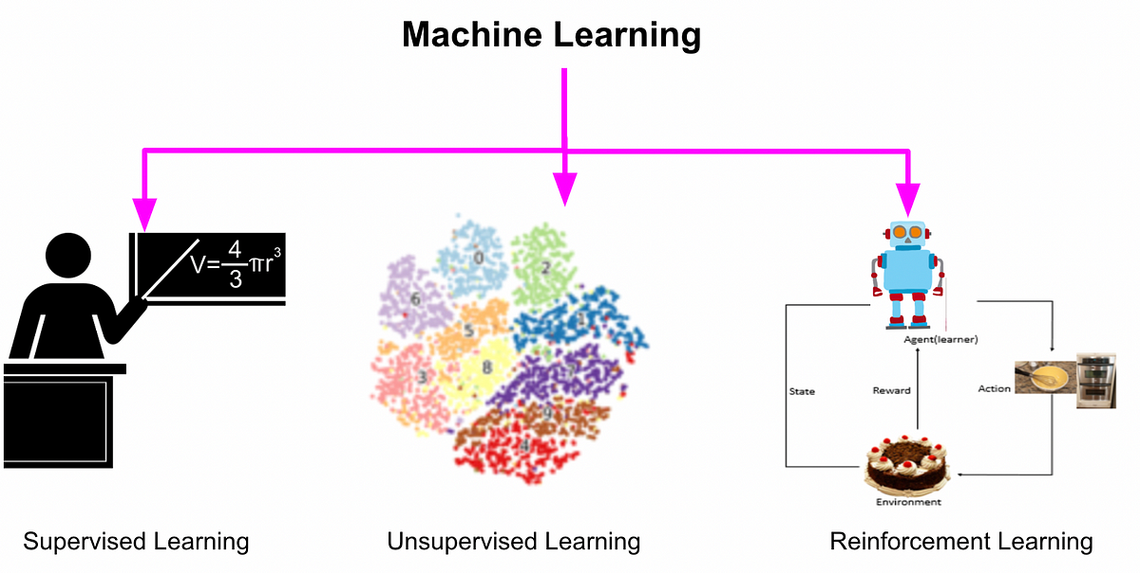

Slide 37
Supervised learning

Slide 38
Continue…
Simple depiction of the supervised learning process.
Labelled training data containing past information comes as an input.
Based on the training data, the machine builds a predictive model that can be used on test data to assign a label for each record in the test data.

Slide 39
Note
Supervised machine learning is as good as the data used to train it.
If the training data is of poor quality, the prediction will also be far from being precise.

Slide 40
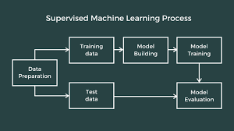
Steps involved in Supervised ML

Slide 41
Examples of Supervised learning
Predicting the results of a game
Predicting whether a tumour is malignant or benign
Predicting the price of domains like real estate, stocks, etc.
Classifying texts such as classifying a set of emails as spam or non-spam

Slide 42
Two Areas Of Supervised Learning
When we are trying to predict a categorical or nominal variable, the problem is known as a classification problem.
Whereas when we are trying to predict a real valued variable, the problem falls under the category of regression.

Slide 43
Classification problems

Slide 44
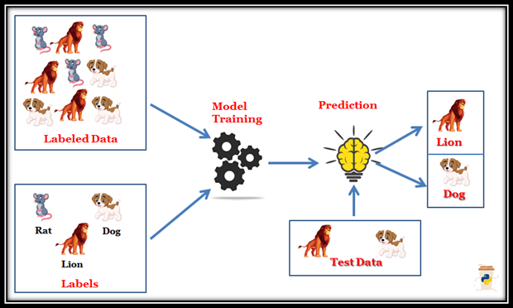

Slide 45
Some typical classification problems include:
Image classification
Prediction of disease
Win–loss prediction of games
Prediction of natural calamity like earthquake, flood, etc.
Recognition of handwriting

Slide 46
Algorithm for solving Classification problems
Naïve Bayes,
Decision tree,
k- Nearest Neighbour

Slide 47
Regression
A regression is a statistical technique that relates a dependent variable to one or more independent (explanatory) variables.
A regression model is able to show whether changes observed in the dependent variable are associated with changes in one or more of the explanatory variables.

Slide 48
Applications of regression
Demand forecasting in retails
Sales prediction for managers
Price prediction in real estate
Weather forecast
Skill demand forecast in job market

Slide 49
Unsupervised Learning
No labelled training data to learn from and no prediction to be made.
In unsupervised learning, the objective is to take a dataset as input and try to find natural groupings or patterns within the data elements or records.
Therefore, unsupervised learning is often termed as descriptive model and the process of unsupervised learning is referred as pattern discovery or knowledge discovery.

Slide 51
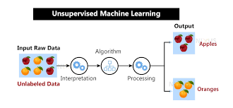

Slide 52
Two types of Unsupervised Learning
Clustering is the main type of unsupervised learning.
It intends to group or organize similar objects together.

Slide 53
Continue…
One of the most commonly adopted similarity measure is distance.
Two data items are considered as a part of the same cluster if the
distance between them is less.
In the same way, if the distance between the data items is high, the items do not generally belong to the same cluster.
This is also known as distance-based clustering

Slide 54
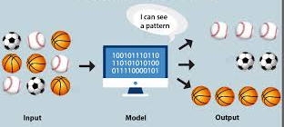

Slide 55
Association analysis
One more variant of unsupervised learning is association analysis
The association between data elements is identified
Common examples, i.e. market basket analysis

Slide 56
Continue…
From past transaction data in a grocery store, it may be observed that most of the customers who have bought item A, have also bought item B and item C or at least one of them.
This means that there is a strong association of the event ‘purchase of item A’ with the event ‘purchase of item B’, or ‘purchase of item C’.
Identifying these sorts of associations is the goal of association analysis.
This helps in boosting up sales pipeline, hence a critical input for the sales group.

Slide 57
Reinforcement learning

Slide 58
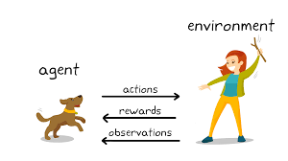

Slide 59
Continue…
When a sub-task is accomplished successfully, a reward is given.
When a sub-task is not executed correctly, obviously no reward is given.
This continues till the machine is able to complete execution of the whole task.
This process of learning is known as reinforcement learning.

Slide 60
Continue…
One contemporary example of reinforcement learning is self-driving cars.
The critical information which it needs to take care of are speed and speed limit in different road segments, traffic conditions, road conditions, weather conditions, etc.
The tasks that have to be taken care of are start/stop, accelerate/decelerate, turn to left / right, etc.

Slide 61
PROBLEMS NOT TO BE SOLVED USING MACHINE LEARNING
Machine learning should not be applied to tasks in which humans are very effective or frequent human. Example : air traffic control
For very simple tasks which can be implemented using traditional programming paradigms. Example: simple rule-driven or formula-based applications.

Slide 62
Continue…
For situations where training data is not sufficient, machine learning cannot be used effectively.
This is because, with small training data sets, the impact of bad data is exponentially worse.
For the quality of prediction or recommendation to be good, the training data should be sizeable.

Slide 63
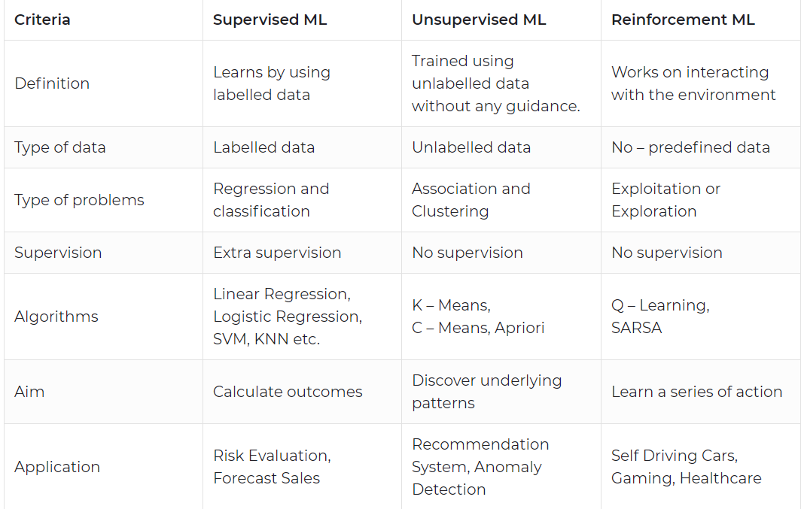

Slide 64
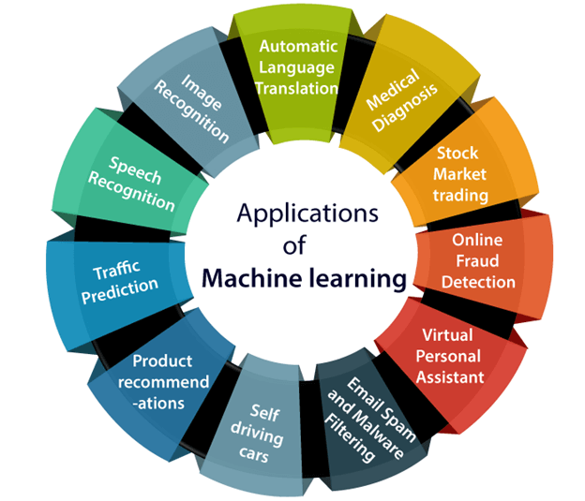

Slide 65
1.9 ISSUES IN MACHINE LEARNING
Self – Learning Topic

Slide 66
Preparing to Model
Chapter - 2

Slide 67
Introduction
To understand the incoming data and create basic understanding about the nature and quality of the data.

Slide 68
2.2 MACHINE LEARNING ACTIVITIES
The first step in machine learning activity starts with data.
In case of supervised learning, it is the labelled training data set followed by test data which is not labelled.
In case of unsupervised learning, it is unlabelled data but the task is to find patterns in the input data.

Slide 69
Continue…
A thorough review and exploration of the data is needed to understand
type of the data
the quality of the data
relationship between the different data elements.

Slide 70
Continue…
Based on that, multiple pre-processing activities need to be done on the input data before we can go ahead with core machine learning activities.

Slide 71
Four-step process of Machine Learning

Slide 72
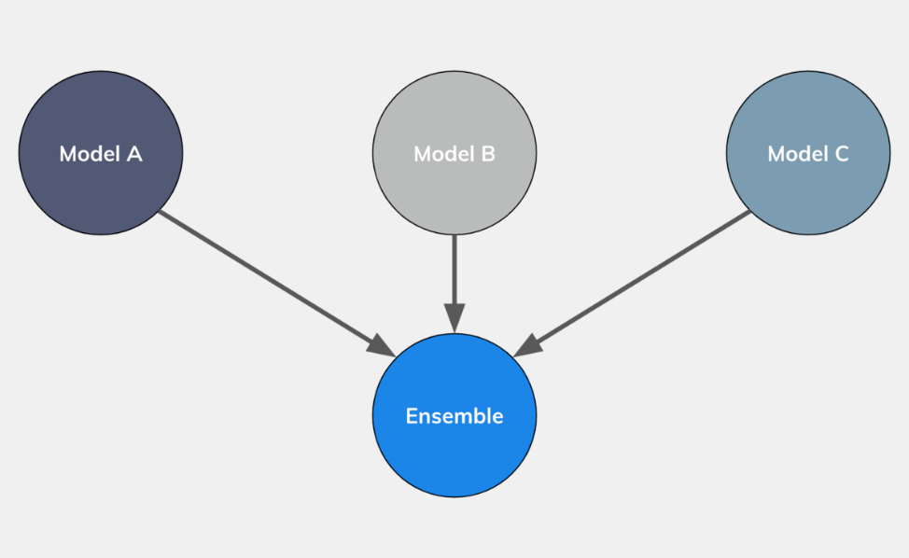
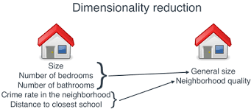
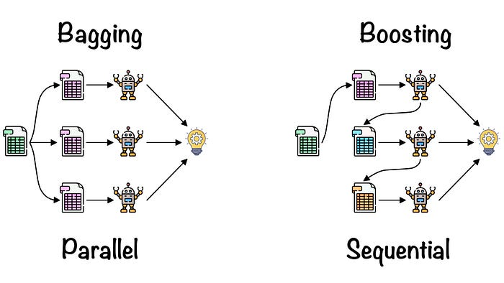
Notes:
receiver operating characteristic curve (ROC curve)

Slide 73
Typical Preparation Activities
Understand the type of data in the given input data set.
Explore the data to understand the nature and quality.
Explore the relationships amongst the data elements, e.g. inter feature relationship.
Find potential issues in data. Do the necessary remediation, e.g. impute missing data values, using mean or median method

Slide 74
Continue…
Once the data is prepared for modelling, then the learning tasks start off. As a part of it, do the following activities:
The input data is first divided into parts – the training data and the test data (called holdout). This step is applicable for supervised learning only.
Consider different models or learning algorithms for selection.
Train the model based on the training data for supervised learning problem and apply to unknown data.
Directly apply the chosen unsupervised model on the input data for unsupervised learning problem.

Slide 75
2.3 BASIC TYPES OF DATA IN MACHINE LEARNING
A data set is a collection of related information or records.
The information may be on some entity or some subject area.

Slide 76
Data can broadly be divided into following two types:
1. Qualitative data
2. Quantitative data

Slide 77
Qualitative data
Qualitative data provides information about the quality of an object or information which cannot be measured.
For example, if we consider the quality of performance of students in terms of ‘Good’, ‘Average’, and ‘Poor’, it falls under the category of qualitative data.
Also, name or roll number of students are information that cannot be measured using some scale of measurement, qualitative data.
Qualitative data is also called categorical data.

Slide 78
Qualitative data
Qualitative data can be further subdivided into two types as follows:
1. Nominal data
2. Ordinal data

Slide 79
Nominal data
Nominal data is one which has no numeric value, but a named value. It is used for assigning named values to attributes.
Nominal values cannot be quantified.
Examples of nominal data are
1. Blood group: A, B, O, AB, etc.
2. Nationality: Indian, American, British, etc.
3. Gender: Male, Female, Other

Slide 80
Ordinal data
Ordinal data, in addition to possessing the properties of nominal data, can also be naturally ordered.
This means ordinal data also assigns named values to attributes but unlike nominal data, they can be arranged in a sequence of increasing or decreasing value so that we can say whether a value is better than or greater than another value.
Examples of ordinal data are
1. Customer satisfaction: ‘Very Happy’, ‘Happy’, ‘Unhappy’, etc.
2. Grades: A, B, C, etc.
3. Hardness of Metal: ‘Very Hard’, ‘Hard’, ‘Soft’, etc.

Slide 81
Quantitative data
Quantitative data relates to information about the quantity of an object – hence it can be measured.
Quantitative data is also termed as numeric data.
There are two types of quantitative data:
1. Interval data
2. Ratio data

Slide 82
Interval data
Interval data is numeric data for which not only the order is known, but the exact difference between values is also known.
An ideal example of interval data is Celsius temperature.
However, interval data do not have something called a ‘true zero’ value.
For example, there is nothing called ‘0 temperature’ or ‘no temperature’.

Slide 83
Ratio
Ratio data represents numeric data for which exact value can be measured.
Absolute zero is available for ratio data
Examples of ratio data include height, weight, age, salary, etc.

Slide 85
Continue…
Attributes can also be categorized into types based on a number of
values that can be assigned.
The attributes can be either discrete or continuous based on this factor.
Example of discrete attribute include roll number, street number, pin code, etc.
Examples of continuous attribute include length, height, weight, price, etc

